Slide 1

NAME – ABHIRUP BAG ROLL – 13000122082 DEPARTMENT – CSE(B) SEMESTER – 6 PAPER – Computer networks (pcc-cs602)
Osi model

Slide 2

INTRODUCTION
OSI stands for Open System Interconnection is a reference model that describes how information from a software application in one computer moves through a physical medium to the software application in another computer.
OSI consists of seven layers, and each layer performs a particular network function.
OSI model was developed by the International Organization for Standardization (ISO) in 1984, and it is now considered as an architectural model for the inter-computer communications.
OSI model divides the whole task into seven smaller and manageable tasks. Each layer is assigned a particular task.
Each layer is self-contained, so that task assigned to each layer can be performed independently.

Slide 3
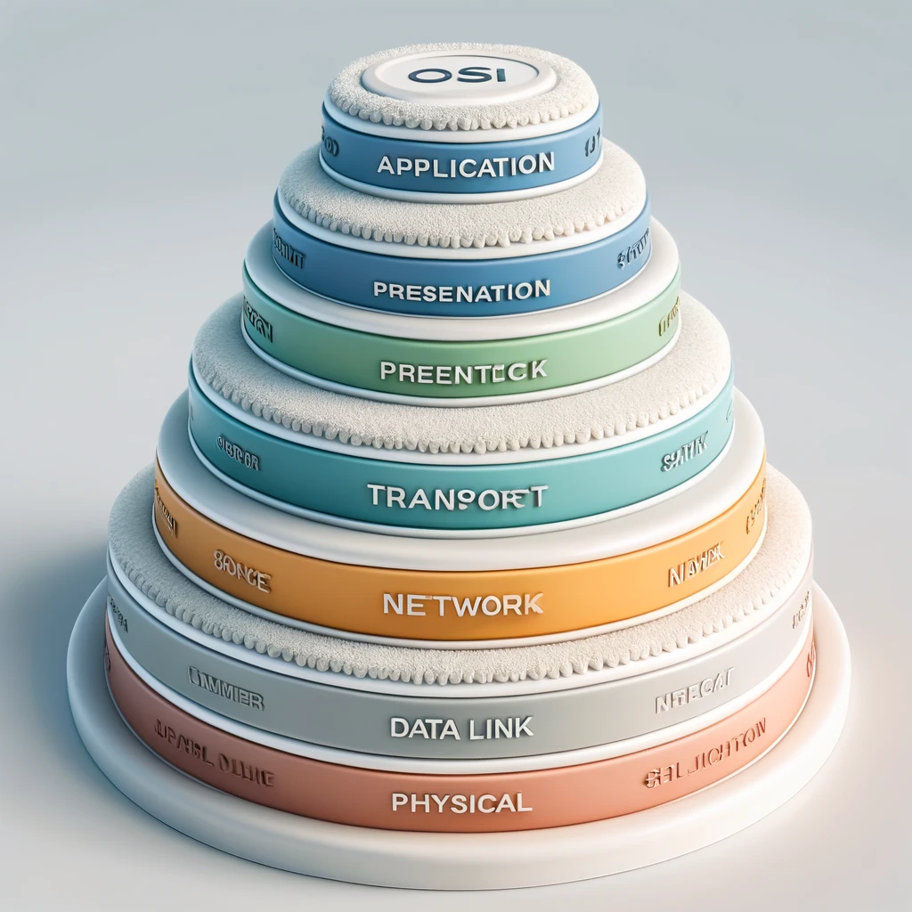
7 Layers of OSI Model
1
Physical Layer
2
Data-Link Layer
3
Network Layer
4
Transport Layer
5
Session Layer
6
Presentation Layer
7
Application Layer

Slide 4

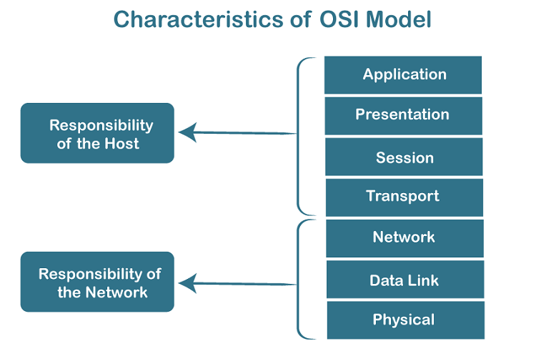
Characteristics of OSI Model:
The OSI model is divided into two layers: upper layers and lower layers.
The upper layers of the OSI model handle application-related issues and are implemented in software. The application layer, closest to the end user, interacts directly with software applications. An upper layer is simply the layer above another.
The lower layers of the OSI model handle data transport. The data link and physical layers are implemented in both hardware and software. The physical layer, the lowest layer, manages placing information on the physical medium.

Slide 5
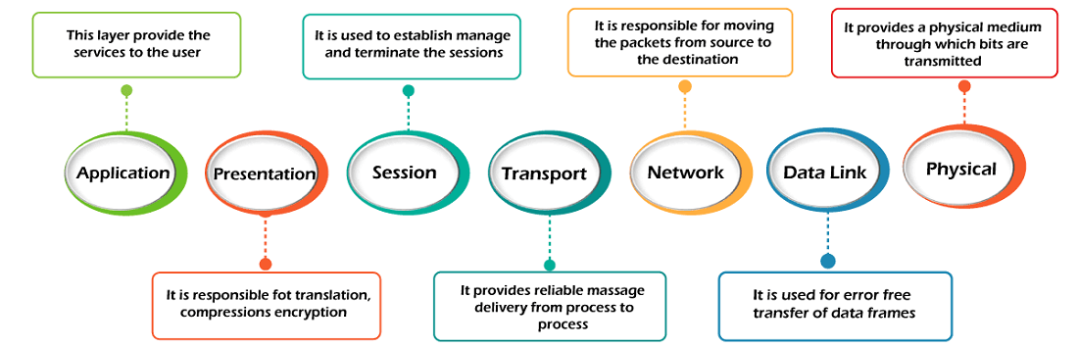
A brief introduction to the layers

Slide 6
1
Physical layer
The main functionality of the physical layer is to transmit the individual bits from one node to another node.
It is the lowest layer of the OSI model.
It establishes, maintains and deactivates the physical connection.
It specifies the mechanical, electrical and procedural network interface specifications.
Examples: Cables (e.g., fiber optics, copper), switches, hubs.

Slide 7

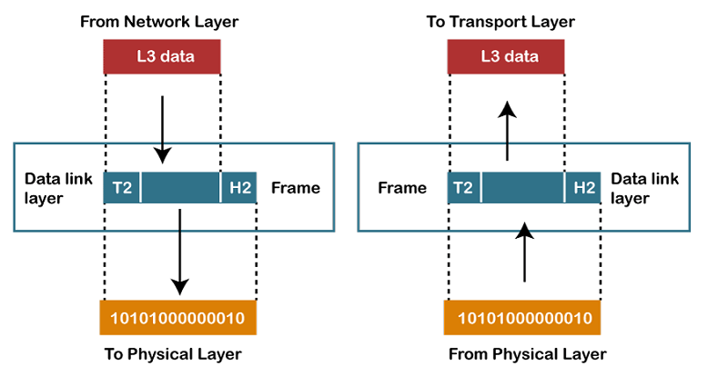
Functions of Physical layer :
Line Configuration: It defines the way how two or more devices can be connected physically.
Data Transmission: It defines the transmission mode whether it is simplex, half-duplex or full-duplex mode between the two devices on the network.
Topology: It defines the way how network devices are arranged.
Signals: It determines the type of the signal used for transmitting the information.

Slide 8
2
Data-Link Layer
This layer is responsible for the error-free transfer of data frames.
It defines the format of the data on the network.
It provides a reliable and efficient communication between two or more devices.
It is mainly responsible for the unique identification of each device that resides on a local network.
Examples: Ethernet, Wi-Fi (IEEE 802.11), PPP.

Slide 9
sub-layers of data-link layer
1
Logical Link Control Layer
It is responsible for transferring the packets to the Network layer of the receiver that is receiving.
It identifies the address of the network layer protocol from the header.
It also provides flow control.
2
Media Access Control Layer
A Media access control layer is a link between the Logical Link Control layer and the network's physical layer.
It is used for transferring the packets over the network.

Slide 10

Functions of the Data-link layer
Framing: The data link layer translates the physical's raw bit stream into packets known as Frames. The Data link layer adds the header and trailer to the frame. The header which is added to the frame contains the hardware destination and source address.
Physical Addressing: The Data link layer adds a header to the frame that contains a destination address. The frame is transmitted to the destination address mentioned in the header.
Flow Control: Flow control is the main functionality of the Data-link layer. It is the technique through which the constant data rate is maintained on both the sides so that no data get corrupted. It ensures that the transmitting station such as a server with higher processing speed does not exceed the receiving station, with lower processing speed.

Slide 11
Error Control: Error control is achieved by adding a calculated value CRC (Cyclic Redundancy Check) that is placed to the Data link layer's trailer which is added to the message frame before it is sent to the physical layer. If any error seems to occur, then the receiver sends the acknowledgment for the retransmission of the corrupted frames.
Access Control: When two or more devices are connected to the same communication channel, then the data link layer protocols are used to determine which device has control over the link at a given time.

Slide 12
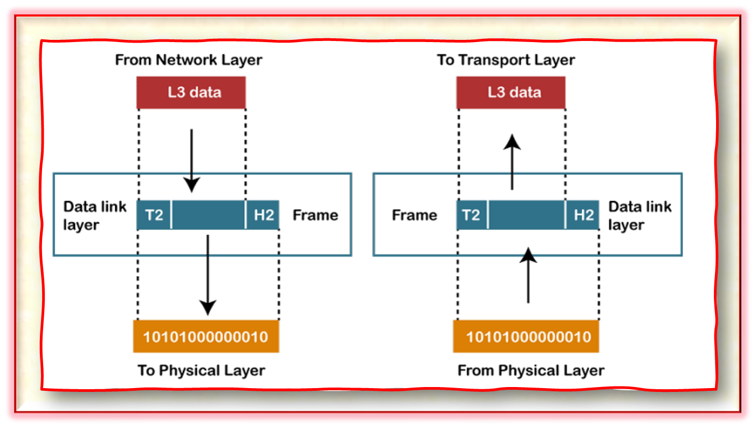
Pictorial representation

Slide 13
3
Network Layer
It is a layer 3 that manages device addressing, tracks the location of devices on the network.
It determines the best path to move data from source to the destination based on the network conditions, the priority of service, and other factors.
The Data link layer is responsible for routing and forwarding the packets.
Routers are the layer 3 devices, they are specified in this layer and used to provide the routing services within an internetwork.
The protocols used to route the network traffic are known as Network layer protocols. Examples of protocols are IP and Ipv6.
Examples: IP (Internet Protocol), ICMP, ARP.

Slide 14
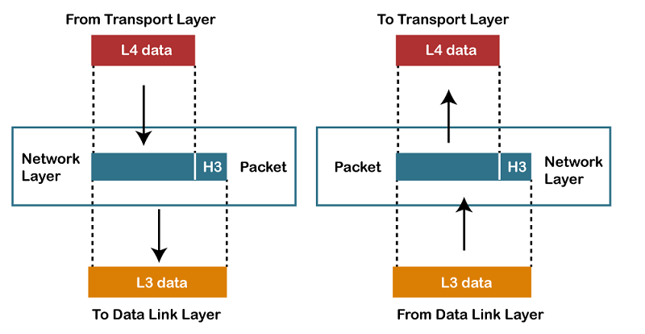
Functions of Network Layer :
Internetworking: An internetworking is the main responsibility of the network layer. It provides a logical connection between different devices.
Addressing: A Network layer adds the source and destination address to the header of the frame. Addressing is used to identify the device on the internet.
Routing: Routing is the major component of the network layer, and it determines the best optimal path out of the multiple paths from source to the destination.
Packetizing: A Network Layer receives the packets from the upper layer and converts them into packets. This process is known as Packetizing. It is achieved by internet protocol (IP).

Slide 15
4
Transport Layer
The Transport layer is a Layer 4 ensures that messages are transmitted in the order in which they are sent and there is no duplication of data.
The main responsibility of the transport layer is to transfer the data completely.
It receives the data from the upper layer and converts them into smaller units known as segments.
This layer can be termed as an end-to-end layer as it provides a point-to-point connection between source and destination to deliver the data reliably.
Examples: TCP (Transmission Control Protocol), UDP (User Datagram Protocol).

Slide 16
The two protocols used in this layer are:
1
Transmission Control Protocol
Standard Protocol – Enables seamless communication over the internet.
Connection Establishment – Creates and maintains reliable connections between hosts.
Data Segmentation – Breaks data into smaller segments for efficient transfer.
Multiple Routes – Segments take different paths and may arrive out of order.
Reordering – TCP ensures correct sequence at the receiving end.
2
User Datagram Protocol
Transport Layer Protocol – UDP operates at the transport layer.
Unreliable Transmission – No guarantee of data delivery.
No Acknowledgment – Receiver doesn’t confirm packet receipt.
No Waiting – Sender transmits without waiting for feedback.
Faster Communication – Ideal for speed-sensitive applications like streaming & gaming.

Slide 17
Functions of Transport Layer :
Service-Point Addressing – Ensures data reaches the correct process using port addresses.
Segmentation & Reassembly – Splits data into segments, assigns sequence numbers, and reassembles them at the destination.
Connection Control – Supports connection-oriented (single route) & connectionless (multiple routes) communication.
Flow Control – Manages data transmission speed end-to-end to prevent congestion.
Error Control – Ensures data reaches the destination without errors through end-to-end checks.

Slide 18
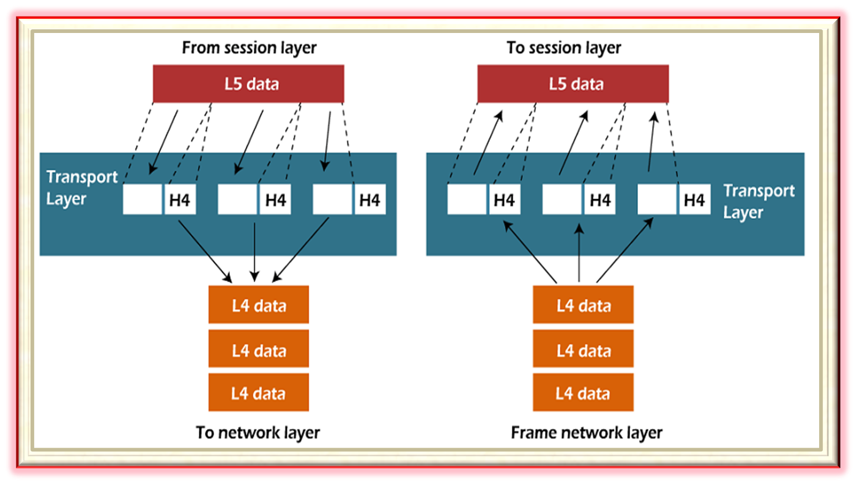
Pictorial representation

Slide 19
5
Session Layer
It is a layer 3 in the OSI model.
The Session layer is used to establish, maintain and synchronizes the interaction between communicating devices.
Examples: NetBIOS, RPC.

Slide 20
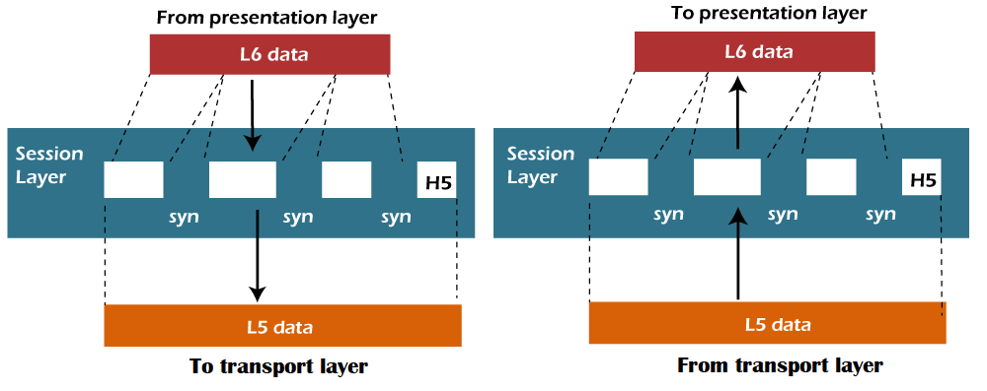
Functions of Session Layer :
Dialog control: Session layer acts as a dialog controller that creates a dialog between two processes or we can say that it allows the communication between two processes which can be either half-duplex or full-duplex.
Synchronization: Session layer adds some checkpoints when transmitting the data in a sequence. If some error occurs in the middle of the transmission of data, then the transmission will take place again from the checkpoint. This process is known as

Slide 21
6
Presentation Layer
A Presentation layer is mainly concerned with the syntax and semantics of the information exchanged between the two systems.
It acts as a data translator for a network.
This layer is a part of the operating system that converts the data from one presentation format to another format.
The Presentation layer is also known as the syntax layer.
Examples: SSL/TLS for encryption, JPEG for image compression.

Slide 22
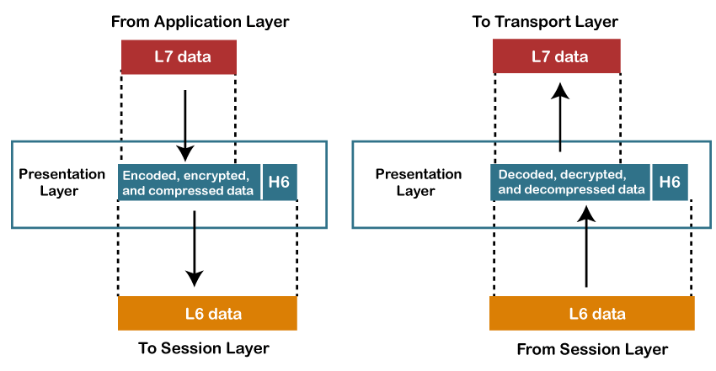
Functions of Presentation Layer :
Translation: The presentation layer ensures interoperability by converting data between different encoding formats. It transforms sender-specific data into a common format and then into the receiver’s format, enabling seamless communication between systems.
Encryption: Encryption is needed to maintain privacy. Encryption is a process of converting the sender-transmitted information into another form and sends the resulting message over the network.
Compression: Data compression is a process of compressing the data, i.e., it reduces the number of bits to be transmitted. Data compression is very important in multimedia such as text, audio, video.

Slide 23
7
Application Layer
An application layer serves as a window for users and application processes to access network service.
It handles issues such as network transparency, resource allocation, etc.
An application layer is not an application, but it performs the application layer functions.
This layer provides the network services to the end-users.
Examples: HTTP, FTP, SMTP, DNS.

Slide 24
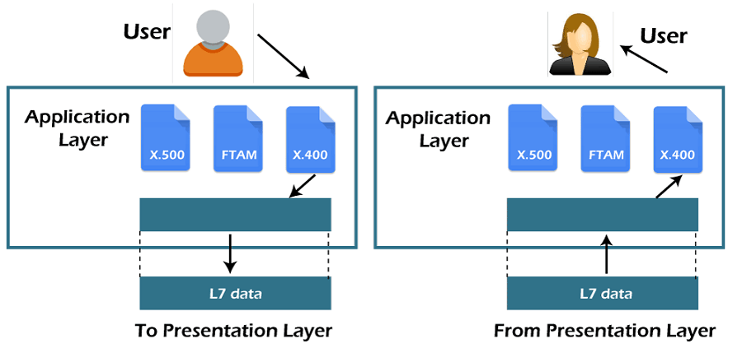
Functions of Application Layer :
File transfer, access, and management (FTAM): An application layer allows a user to access the files in a remote computer, to retrieve the files from a computer and to manage the files in a remote computer.
Mail services: An application layer provides the facility for email forwarding and storage.
Directory services: An application provides the distributed database sources and is used to provide that global information about various objects.

Slide 25
How Data Flows Through the OSI Model
Encapsulation Process:
Data moves down the layers from the Application Layer to the Physical Layer, with each layer adding its own header (encapsulation).
2
Decapsulation Process:
At the receiving end, data moves up the layers, with each layer removing its header (decapsulation).
1

Slide 26
Importance of the OSI Model
Benefits:
Standardizes network communication.
Simplifies troubleshooting by isolating issues to specific layers.
Promotes interoperability between different vendors and technologies.
Real-World Applications:
Used in designing networks, troubleshooting, and understanding protocols.

Slide 27
OSI Model vs. TCP/IP Model
Comparison:
OSI Model: 7 layers, theoretical framework.
TCP/IP Model: 4 layers, practical implementation.
Similarities:
Both models describe network communication processes.
Differences:
TCP/IP combines some OSI layers (e.g., Application, Presentation, and Session layers into one).

Slide 28
Conclusion
The OSI model is a foundational framework that simplifies network communication by dividing it into seven layers, each with a specific role. From user interaction at the Application Layer to data transmission at the Physical Layer, it ensures interoperability, efficient troubleshooting, and standardization across technologies.
While practical implementations often use models like TCP/IP, the OSI model remains essential for understanding and designing networks. Its layered approach empowers professionals to diagnose issues and innovate effectively.
In short, the OSI model is the blueprint that keeps our digital world connected. Thank you, and I’m happy to take any questions!

Slide 29
REFERENCES
📘 "Computer Networking: A Top-Down Approach" – James F. Kurose & Keith W. Ross
📗 "Data Communications and Networking" – Behrouz A. Forouzan
📙 "Computer Networks" – Andrew S. Tanenbaum & David J. Wetherall
📕 "TCP/IP Illustrated, Volume 1: The Protocols" – W. Richard Stevens
📓 "Internetworking with TCP/IP" – Douglas E. Comer

Slide 30



